Slide 1
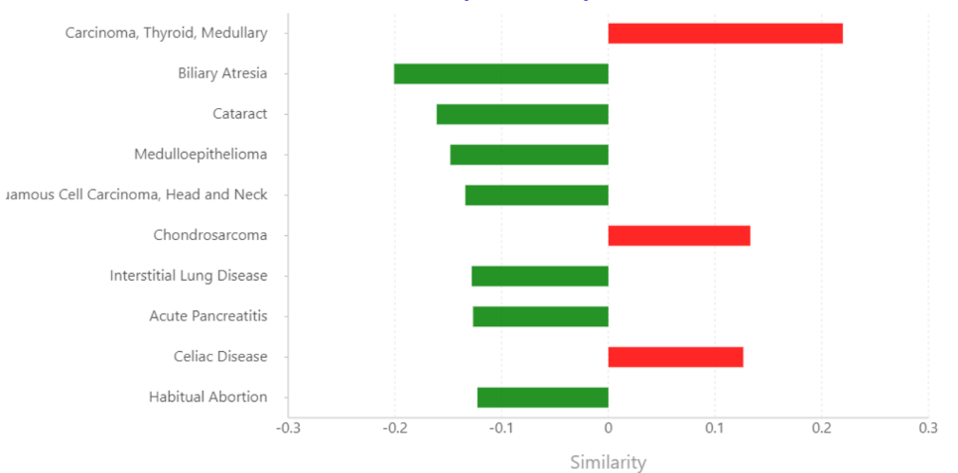
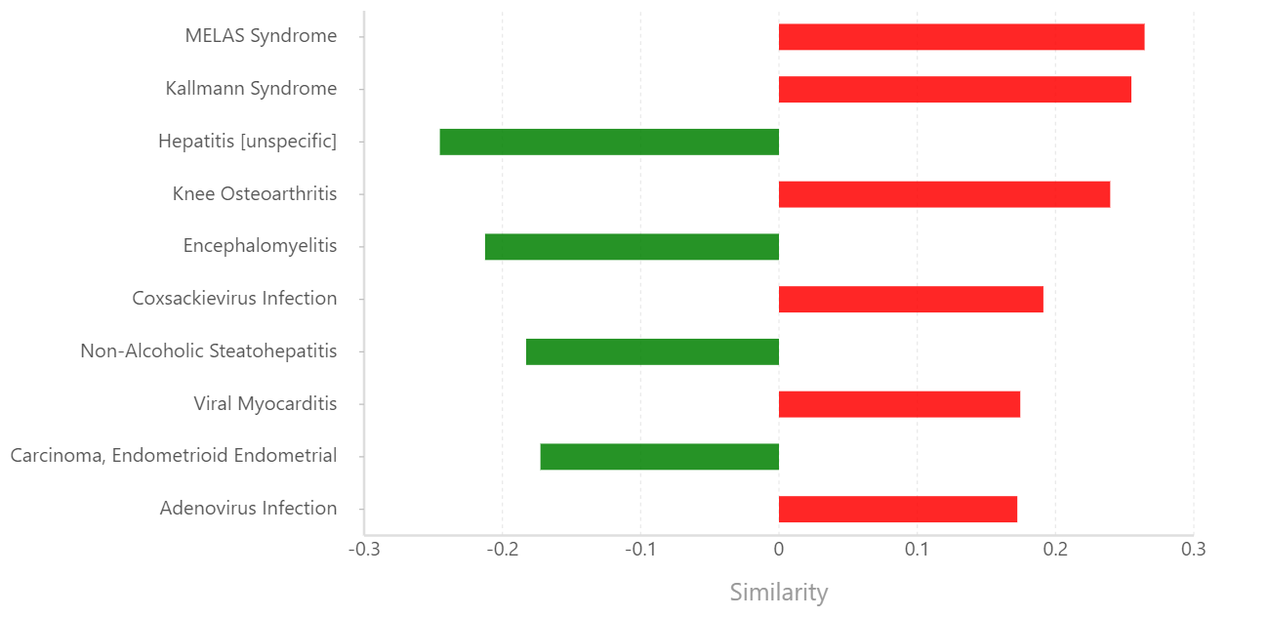
Male
Female
Bar plot depicting the similarities between user-provided de-regulated miRNAs and the de-regulated miRNAs in other disease conditions

Slide 2
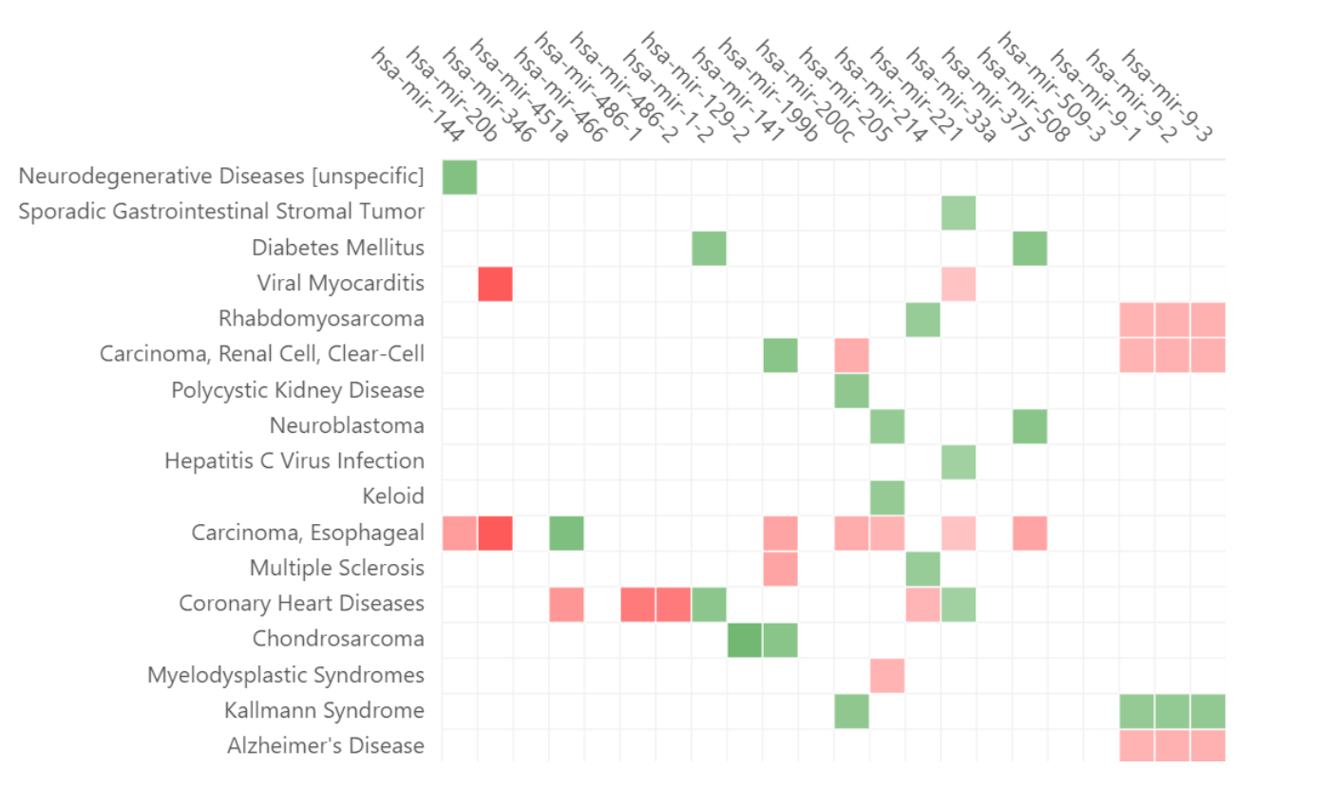
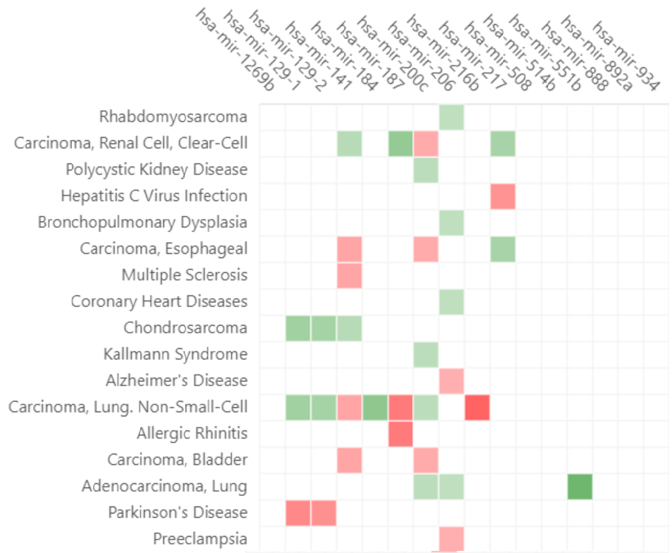
Male
Female
This heatmap depicts the holistic view of miRNA de-regulation in the CUARATED DISEASE CONDITIONS. The palette correlates with the association score (de-regulation score, corrected for the specificity of miRNA de-regulation). The down-miRNAs are indicated by green boxes while the up-miRNAs are indicated by red boxes.

